Slide 1

Automatic Toll Collection System Using RFID
BACHELOR OF TECHNOLOGY
IN
ELECTRONICS & TELE-COMMUNICATION ENGINEERING
(2019-23)
vinay b patil (19070123075)

Slide 2
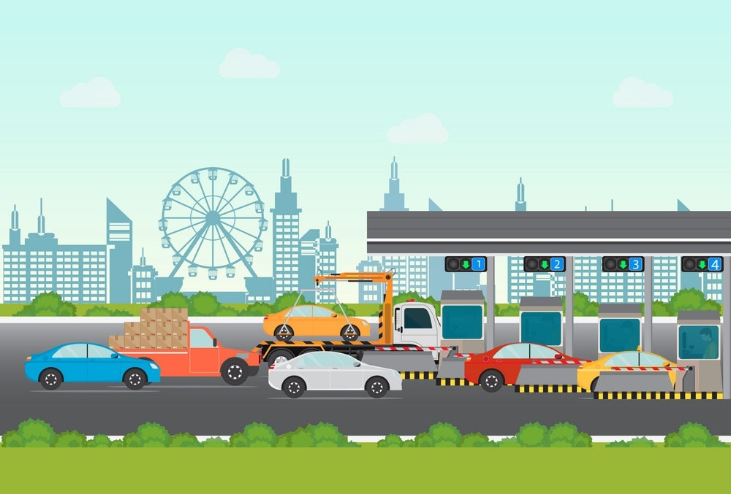
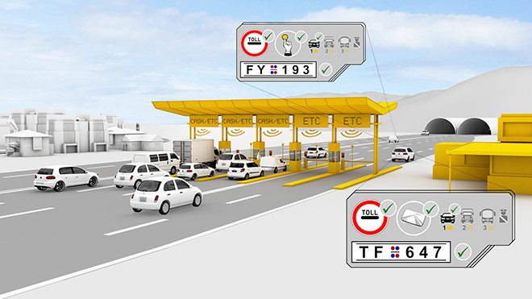
abstract
The automated toll collection system using passive Radio Frequency Identification (RFID) tag emerges as a convincing solution to the manual toll collection method employed at tollgates. Time and efficiency are a matter of priority of present day. In order to overcome the major issues of vehicle congestion and time consumption RFID technology is used.

Slide 3
Table of contents
1. INTRODUCTION ……………………………………………………….…………………………….4
2. METHODOLOGY……………………………………………………………………………………..6
3. CIRCUIT DIAGRAM……………………………………………………….….……………………..8
4. WORKING PRINCIPLE……………………………………………………………………………….8
5. BLOCK DIAGRAM……………………………………………………………………………………..9
6. RESULT….……………………………………………………………………………………………….11
7. CONCLUSION ………………………………………………………………………………………..12
8. WORK CITED ..…..…………………………………………………………………………………..13

Slide 4
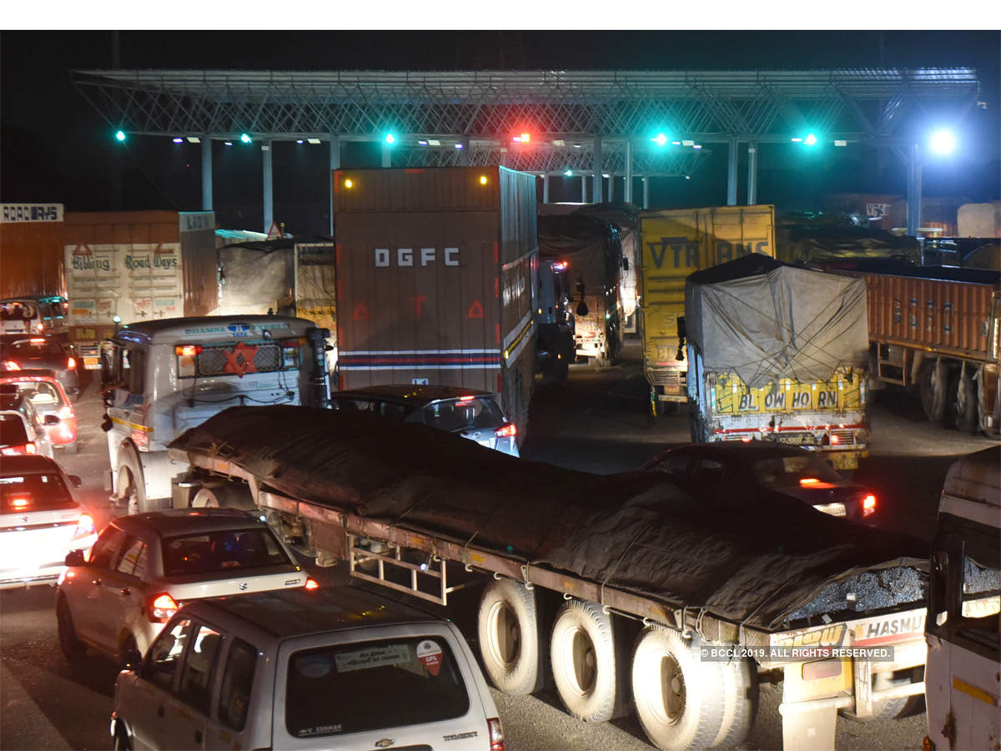
introduction
As we all know that transportation is the backbone of any country’s economy. Improvement in transportation systems result into the good lifestyle in which we achieve extraordinary freedom for movement, immense trade in manufactured goods and services, as well as higher rate of employment levels and social mobility. In fact, the economic condition of a nation has been closely related to efficient ways of transportation. Increasing number of vehicles on the road, result into number of problems such as congestion, accident rate, air pollution and many others.

Slide 5
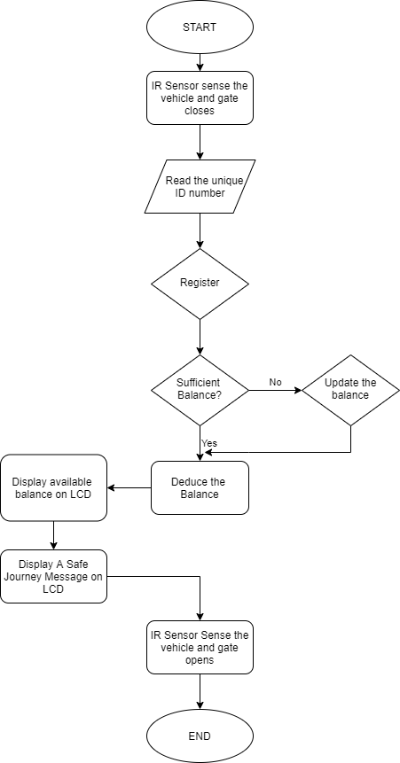
METHODOLOGY
Whenever any person buys a vehicle, first he/she need to do her vehicle registered at the RTO office. RTO people will assign a number plate to it along with it they will give a RFID enabled tag. This card will have a unique ID feasible to use with that vehicle only. They will also create an account for that particular smart card and maintain transaction history in database. Every time a registered vehicle approaches the toll booth, first the infrared sensors will detect the presence of the vehicle which in turn activate the RFID circuit to read the RFID enable smart card fixed on the windscreen of the vehicle.

Slide 6
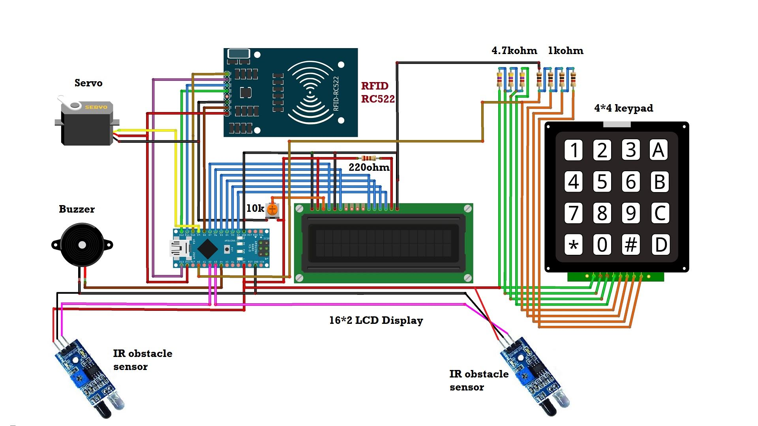
Circuit Diagram

Slide 7
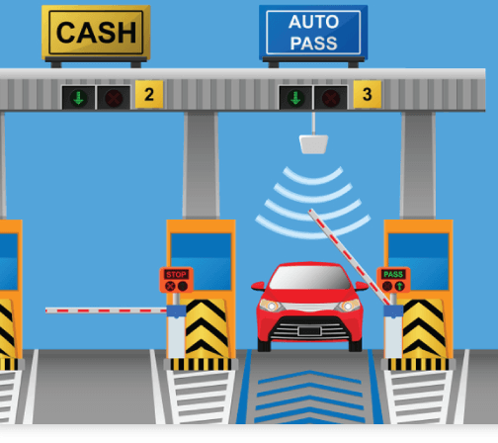
Working principal
In my project, I have a vehicle equipped with RFID tag. Whenever the vehicle enters the infrared sensor detects the presence of vehicle, it rfid reader decodes the code assigned to that particular tag. After receiving the code, it is forwarded to the computer situated at the Toll station. The computer then recognizes the code and automatically access the database and if the vehicle has its valid prepaid account at the toll station, the appropriate toll is deducted from that account and the gate is opened to allow the vehicle to pass. And if the vehicle doesn’t have a valid prepaid account.

Slide 8
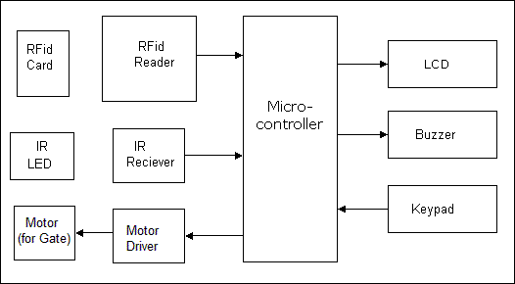
Block
Diagram

Slide 9
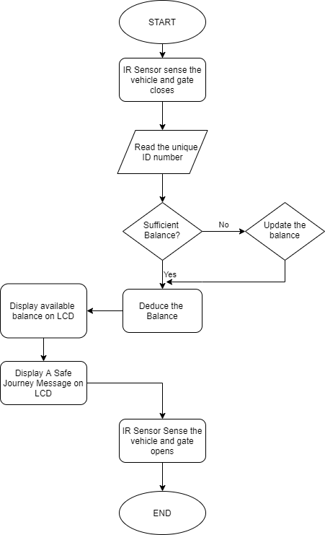
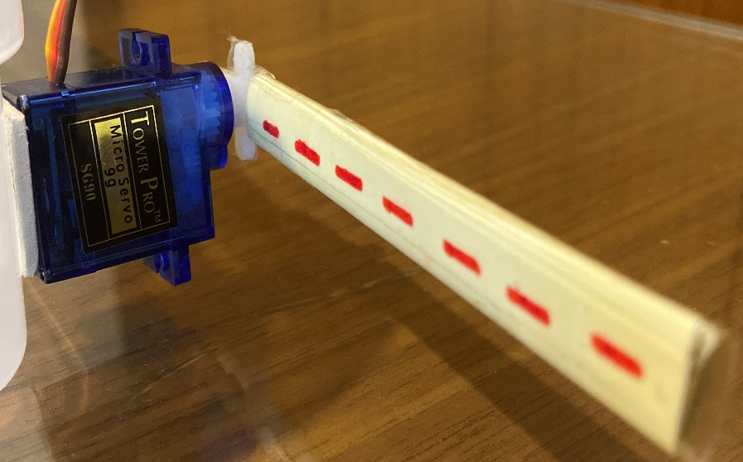
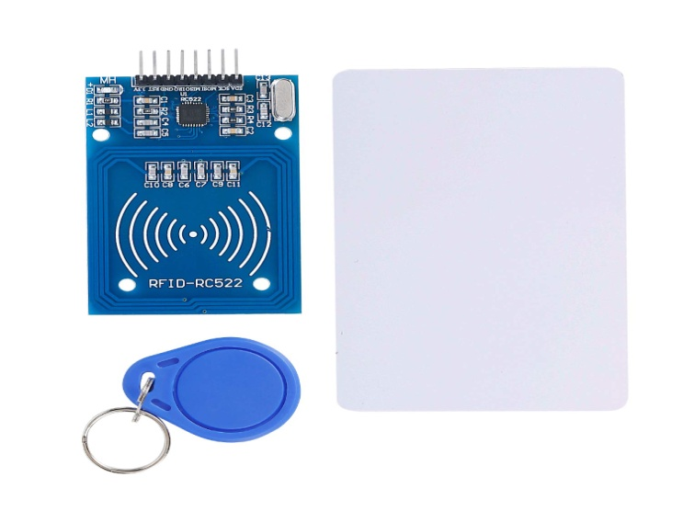
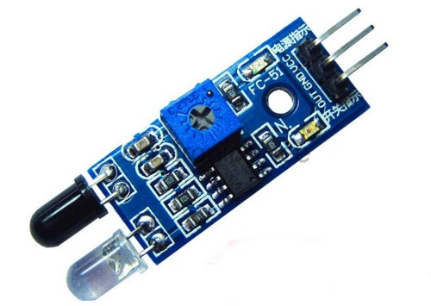

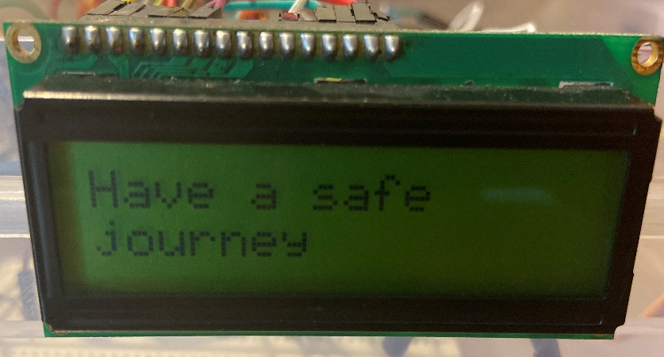
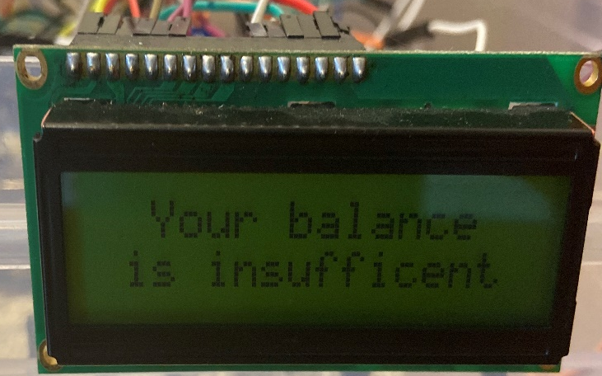
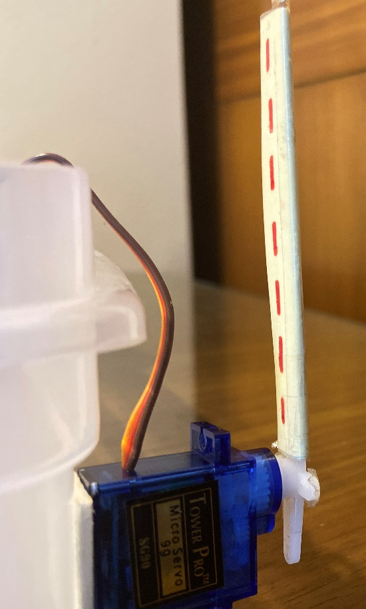
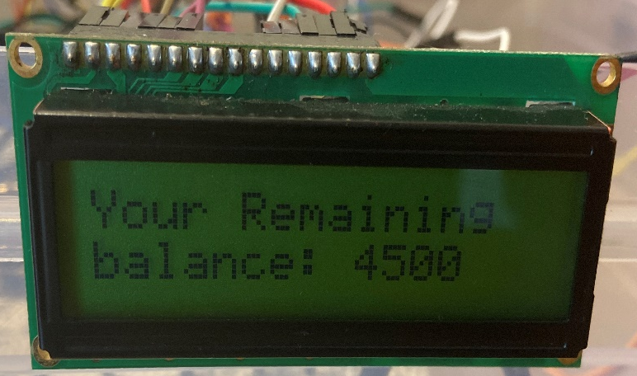

Slide 10
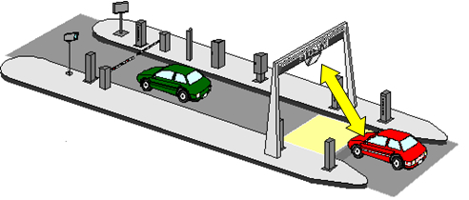
result
RFID based toll collection system is used as a technology for fast and efficient collection of toll at the toll booths. This is possible for the vehicles passing through the toll plaza need not stop to pay toll and the payment automatically is deducted from the account of the driver. These Rfid (tags) are fitted on the windshield of the vehicle . The tags have all the information regarding the users account. The Rfid reader continuously send radio frequency pulses which returns only when hits a Rfid tag. These pulses are returned back from the tag and are received by the rfid reader. These reflected pulses from the tags contain information about the driver number, drivers account, balance etc. The main system components are as follows:
RFID tagged vehicle
Toll booth equipped with RFID scanners
Sensors

Slide 11
conclusion
Following are the features and advancement of RFID Toll Booth System over presently existing system:
RFID tag cannot be cloned, so cannot be cheated.
Very efficient saving of time.
Wastage of money reduced.
Consumption of oil is reduced.
Pollution is reduced to a large extent.
Speedy transport.
Less congestion on the roadways.
Comparatively less maintenance cost .

Slide 12
Work cited
1. https://en.wikipedia.org/wiki/Electronic_toll_collection
2. http://www.iosrjournals.org/iosr-jce/papers/Vol9-Issue2/L0926166.pdf?id=283
3. https://www.ijcsmc.com/docs/papers/August2016/V5I8201645.pdf
4. https://www.skyfilabs.com/project-ideas/rfid-based-toll-collection-system

